Slide 1

By: Dong Zhen

Slide 2



About Yo-Local Snacks
WHO ARE THEY?
THEIR OBJECTIVE
MY JOB
A non-profit snack shop located in Park Slope, Brooklyn who works with local snack vendors to sell traveler snacks to commuters
Plan to open a new store near residents with long commute times
Use public MTA data to find the flow of commuter traffic by stations

Slide 3
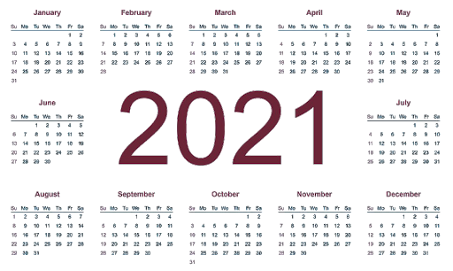
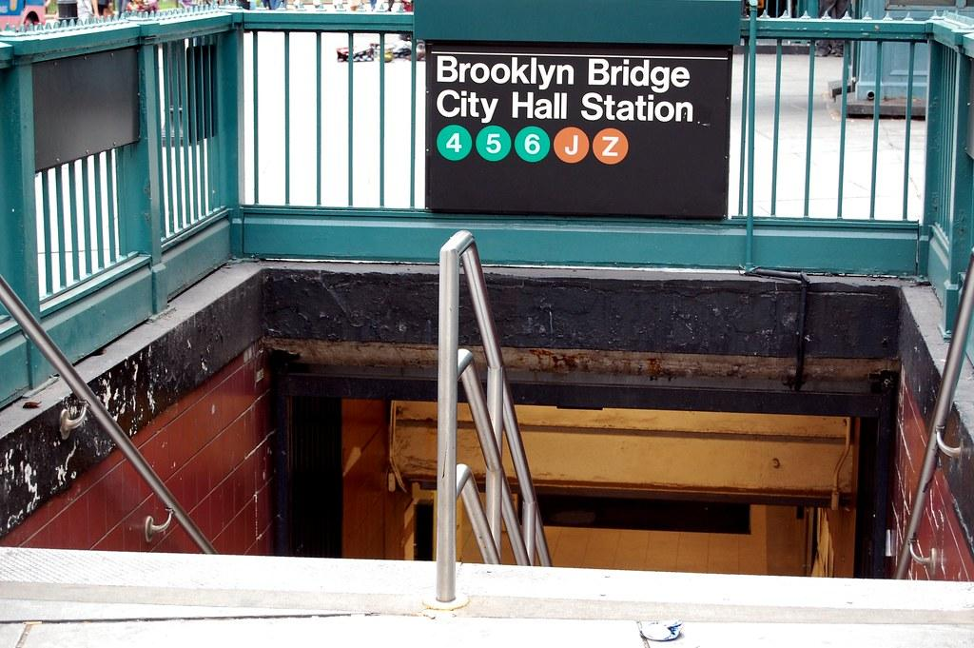

Dataset & Tools
THE PROCESS
Extracted three different MTA datasets
Stored datasets into SQLITE database
Cleaned, analyzed and plotted on PYTHON
DATA FILTERS
Weekday
Entry & Exit Outliers
Not Manhattan
Notes:
Utilized three different MTA datasets: turnstile, stations in Brooklyn and Queens, and local data ridership for January - April, 2021.
Stored the extracted data into a SQLITE database.
Cleaned, analyzed and plotted on PYTHON.
Provide some background on the cleaning
Something to be mindful of:
While cleaning the turnstile data the counters for entries and exits reveal numbers in the hundreds of millions or billions. And had to be filtered out
Total ridership for April was only 180million

Slide 4

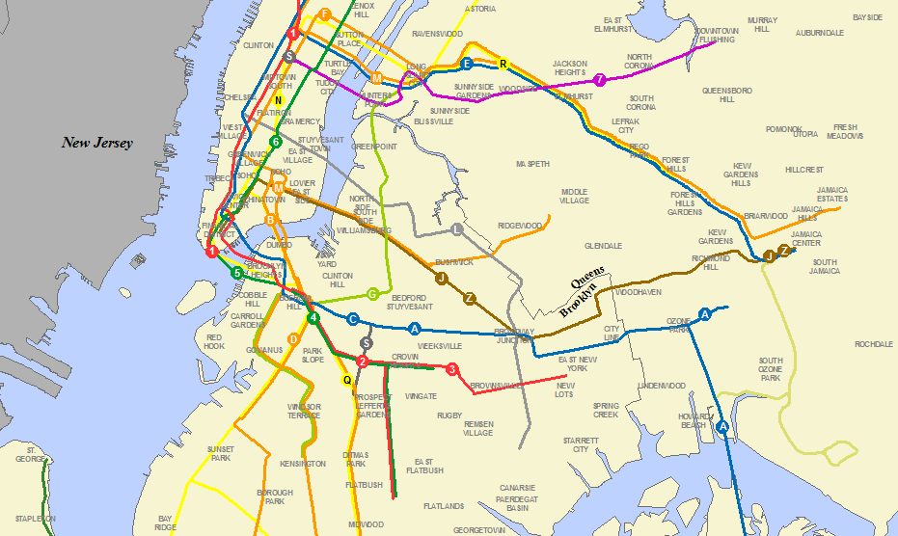

High entry in the morning
High Traffic Commuter Stations
High exit in the evening
Entries matching exits by end of day
Key
Identifiers
Long Commuters

Slide 5
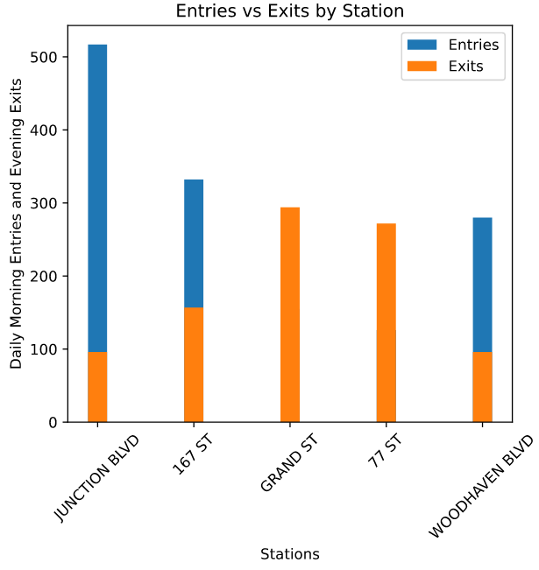
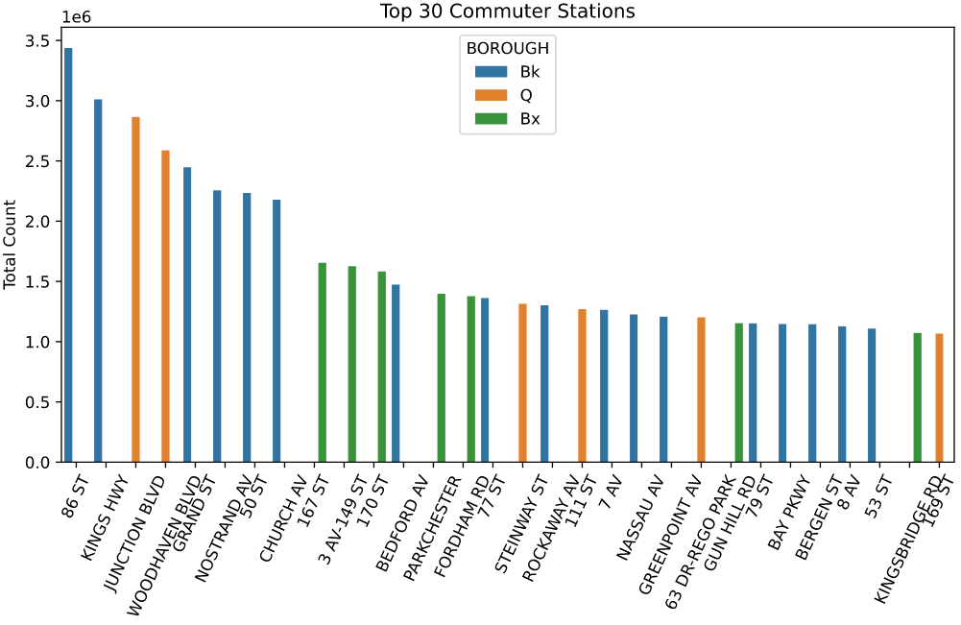
Results

Slide 6
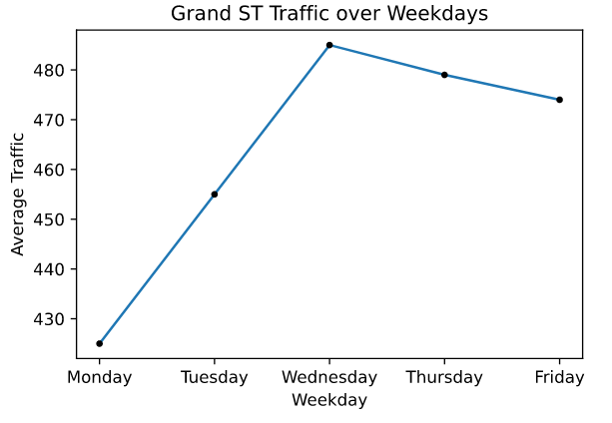
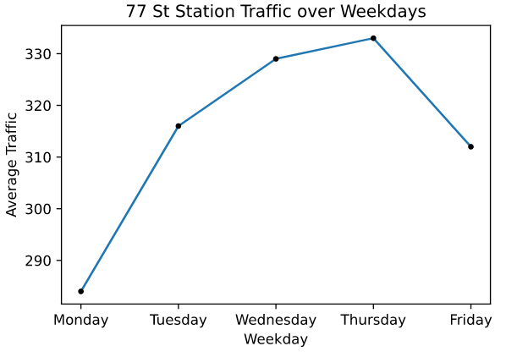
Results Cont.

Slide 7

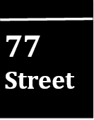
Conclusion
Top Potential Location
Similar flow of New Yorkers entering and exiting during meal hours
Steady weekday traffic
Steady increased traffic in January and February

Slide 8



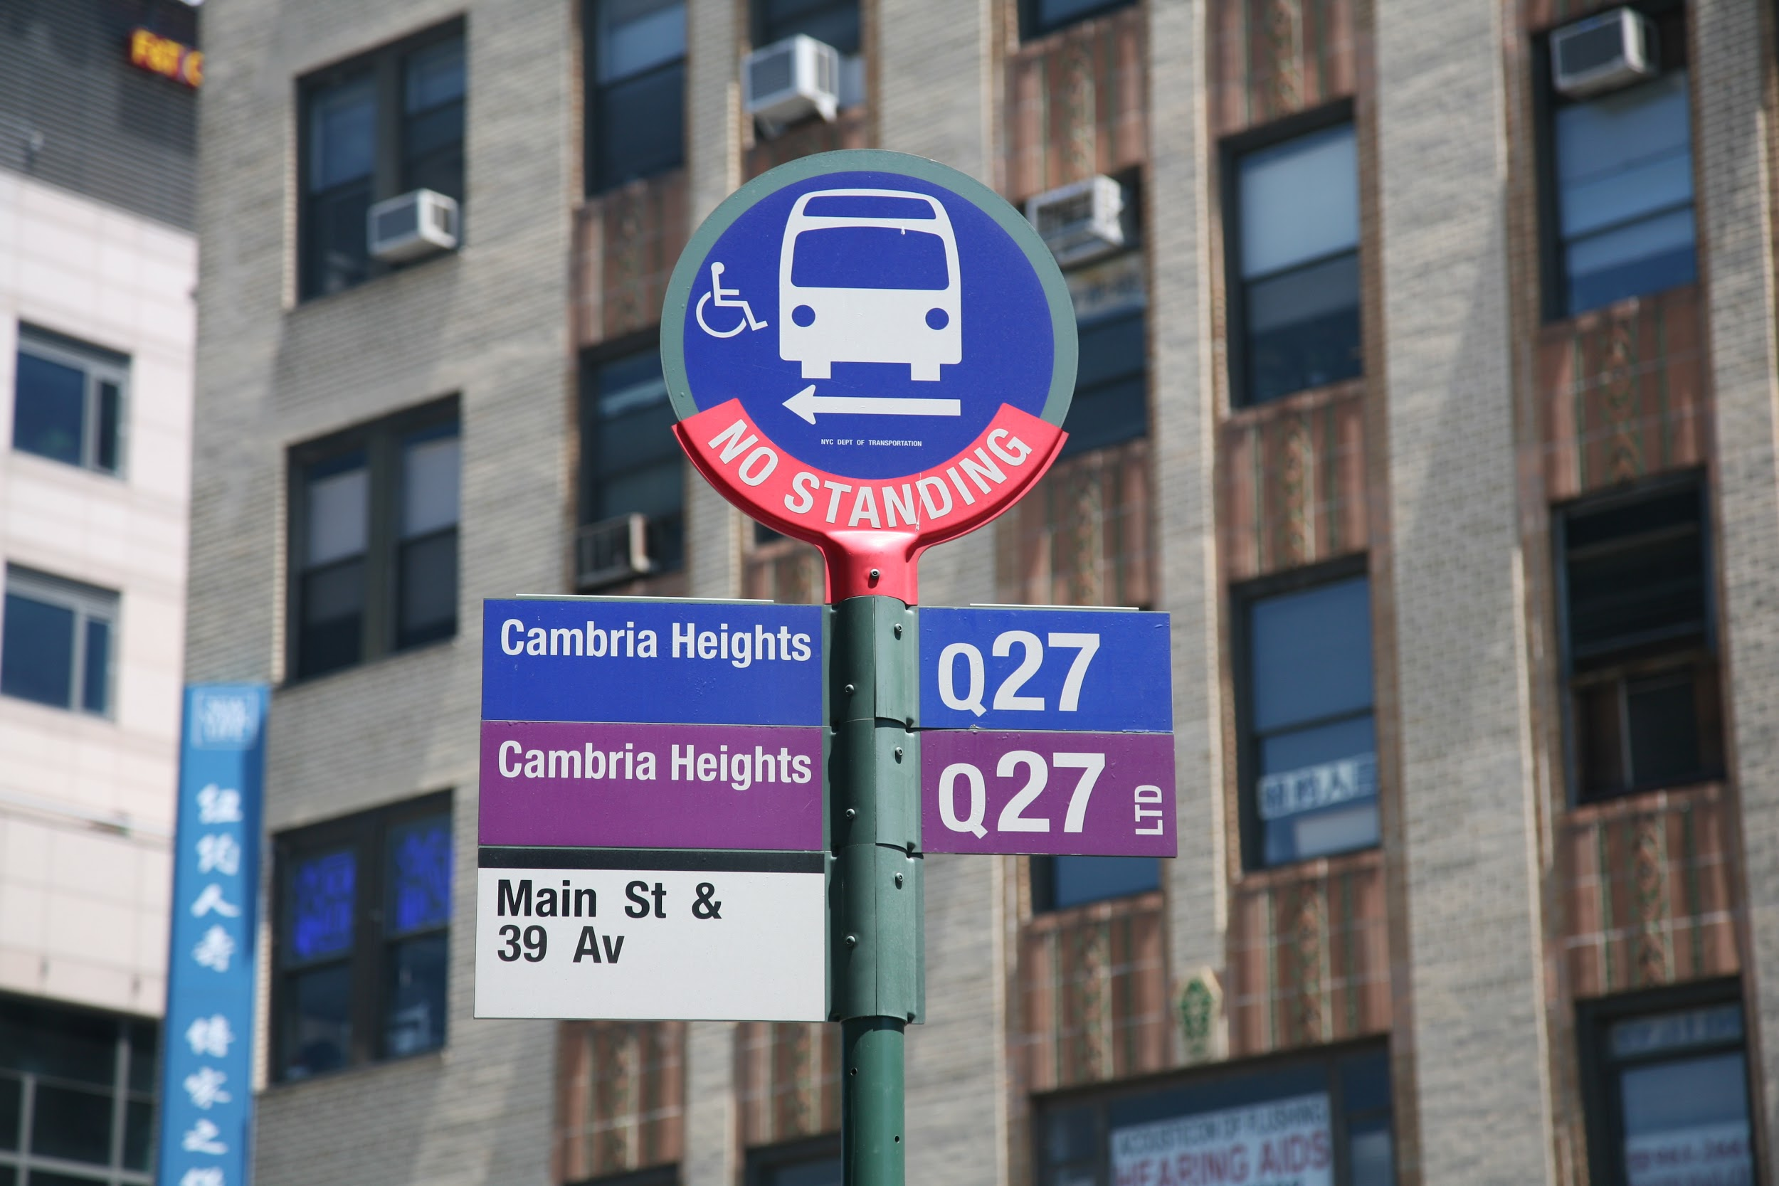
Future
Work
Tap into the demographics
Expand data analysis into Manhattan
Look into New Yorkers who have limited time to eat
Investigate MTA Bus Station data

Slide 9
Appendix
Metropolitan Transport Authority: Real-Time Feeds
Dong Zhen’s Github: MTA Turnstile Traffic and Snacks

